Slide 1
sM = true
f = 0.7
tmax = 40
ks = 2
cs = 200
Fpert = 20

Slide 2
sM = FALSE
f = 0.7
tmax = 40
ks = 2
cs = 200
Fpert = 20

Slide 3
sM = true
f = 0.5
tmax = 40
ks = 2
cs = 200
Fpert = 20

Slide 4
sM = true
f = 0.7
tmax = 20
ks = 2
cs = 200
Fpert = 20

Slide 5
sM = true
f = 0.7
tmax = 40
ks = 1
cs = 200
Fpert = 20

Slide 6
sM = true
f = 0.7
tmax = 40
ks = 2
cs = 100
Fpert = 20

Slide 7
sM = true
f = 0.7
tmax = 40
ks = 2
cs = 200
Fpert = 10

Slide 8
sM = true
f = 0.7
tmax = 40
ks = 5
cs = 50
Fpert = 15

Slide 9
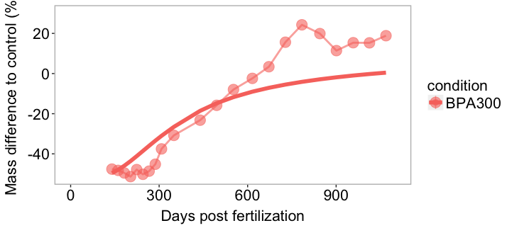
param_spring_damper = c(ks = 0.5, cs = 30, Fpert_BPA03 = 0.001, Fpert_BPA3 = 3.5,
Fpert_BPA30 = 4, Fpert_BPA300 = 20, Fpert_BPA100 = 5)
tmin=0
tmax=40
# Mode of action "p.M", "E.G" or "p_Am"
MoA = "p.M"

